Slide 1
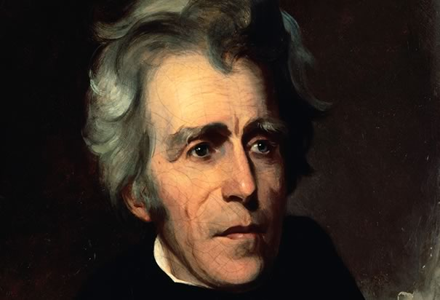
The life of Andrew Jackson
By Bobby Maniaci

Slide 2
Andrew Jackson was born on March 15, 1767

Slide 3
Andrew Jackson was born in Waxhaw's

Slide 4
His childhood was bad because he was poor. His parents names were Andrew and Elizebeth. He had two brothers both older than him, Hugh and Robert.

Slide 5
No one won the election of 1824 because you needed 131 votes and john adams only got 90

Slide 6
His nickname was Old Hickory because he was hard as a hickory tree
He was a democrat and he was supported by the vice president Van Buren.

